Slide 1

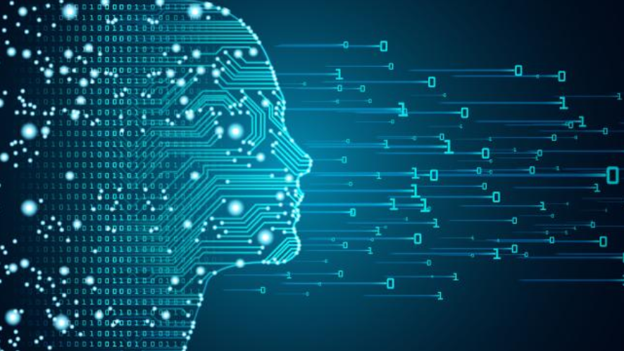

Do It Yourself Natural Language Processing
Susan Li
https://medium.com/@actsusanli
https://www.linkedin.com/in/susanli/
Sr. Data Scientist

Slide 2
Talk Overview
Learning Word2Vec embeddings
Recurrent neural networks for NLP
Convolutional neural networks for NLP
All the materials for this tutorial are in this Github repo:
https://github.com/susanli2016/PyCon-Canada-2019-NLP-Tutorial

Slide 3
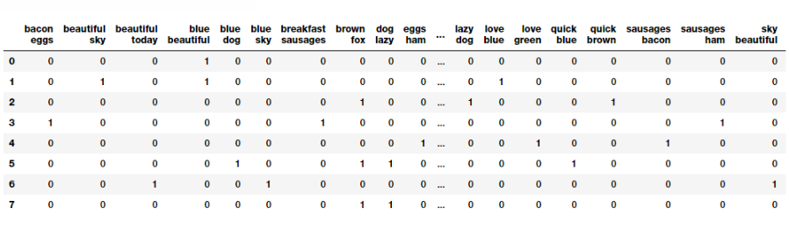
One-Hot Encoding Sparse Representation

Slide 4
Sparse Representation
Encodings are arbitrary
Provide no useful information on how words related to each other.
Leads to data sparsity (So, we need more data)

Slide 5
Word2Vec
Word2vec is a particularly computationally-efficient predictive model for learning word embeddings from raw text
So that the similar words are mapped to nearby points

Slide 6
What is / is not Word2Vec
It is:
A two-layer neural net that processes text
Word embeddings
Vector Space Model based
It is not:
A deep neural network
It turns text into a numerical form that deep nets can process as input.

Slide 7
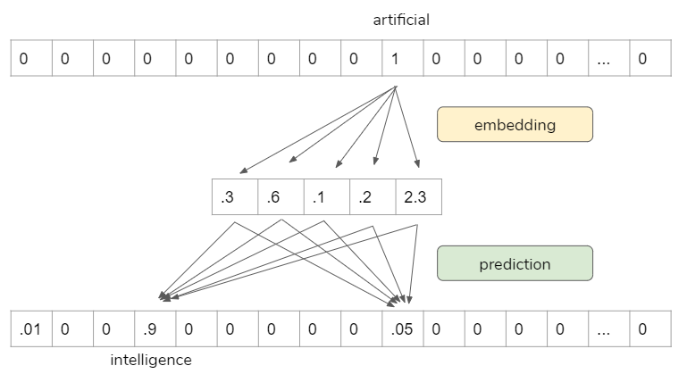
Susan is attending an artificial intelligence conference

Slide 8
How the model is trained
Move through the training corpus with a sliding window: Each word is a prediction problem.
The objective is to predict the current word using the neighboring words (or vice versa).
The outcome of the prediction determines whether we adjust the current word vector. Gradually, vectors converge to (hopefully) optimal values.
The prediction itself is not our goal. It is a proxy to learn vector representations so that we can use it for other tasks.

Slide 9
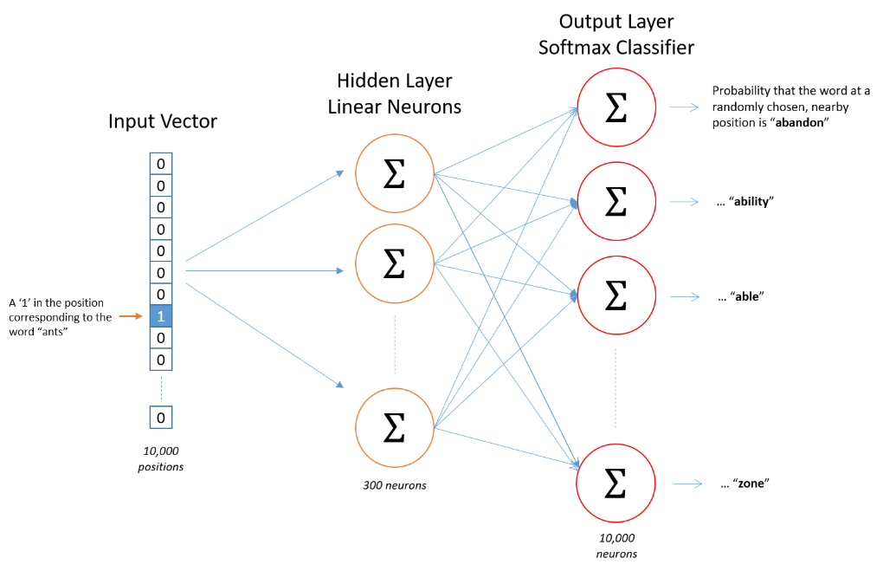
Word2vec Skip-gram Network Architecture
http://mccormickml.com/2016/04/19/word2vec-tutorial-the-skip-gram-model/

Slide 10
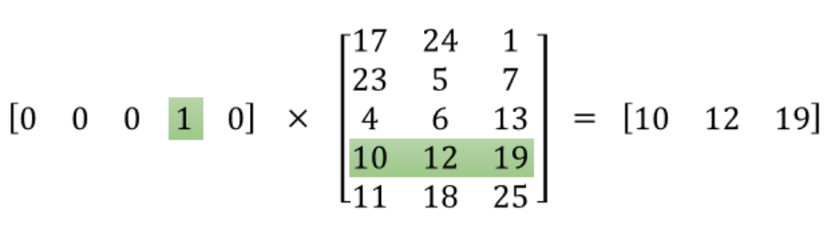
Word2vec Embedding Layer

Slide 11
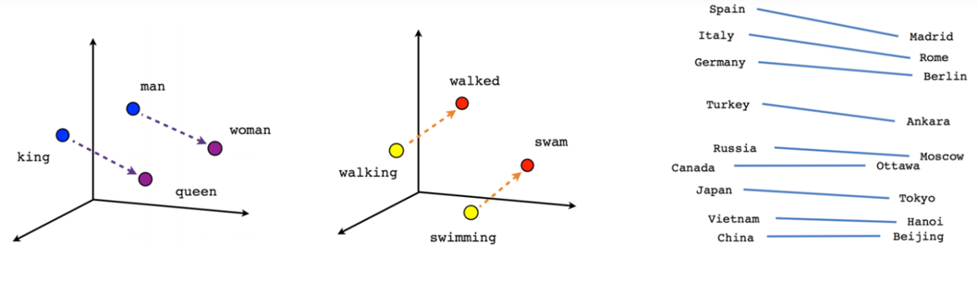
Word2vec results

Slide 12
Do it yourself
Word2vec Embedding for a BBC news data set

Slide 13
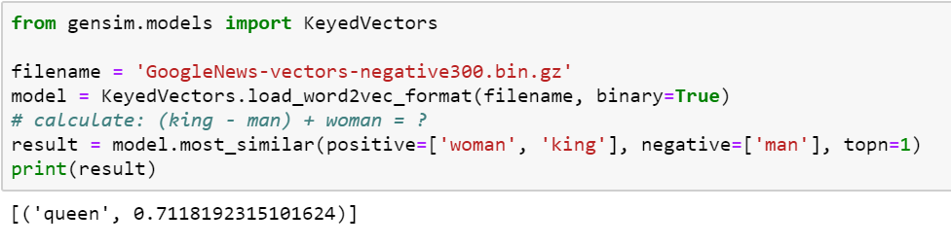
Do it yourself

Slide 14
Recurrent Neural Networks (RNNs)
RNNs can make use of sequential information.
RNNs can use their internal memory to process arbitrary sequences of inputs.
RNNs use time-series information. i.e. what I spoke last will impact what I will speak next.
RNNs are ideal for text and speech analysis.
Most commonly used type of RNNs are LSTMs

Slide 15
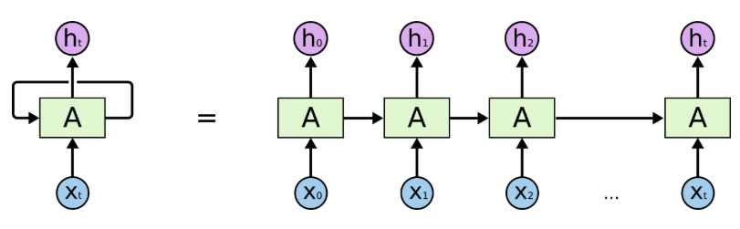
Recurrent Neural Networks (RNNs)
https://colah.github.io/posts/2015-08-Understanding-LSTMs/

Slide 16
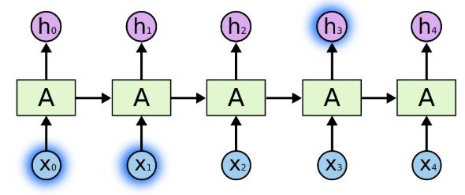
Recurrent Neural Networks (RNNs)
https://colah.github.io/posts/2015-08-Understanding-LSTMs/

Slide 17
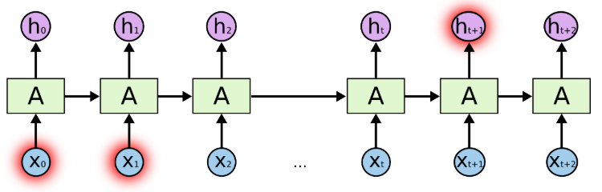
Long term dependency problem
https://colah.github.io/posts/2015-08-Understanding-LSTMs/

Slide 18
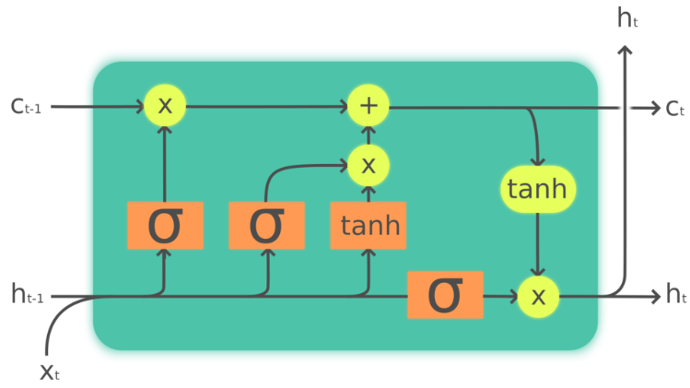
Long short term memory (LSTMs)

Slide 19
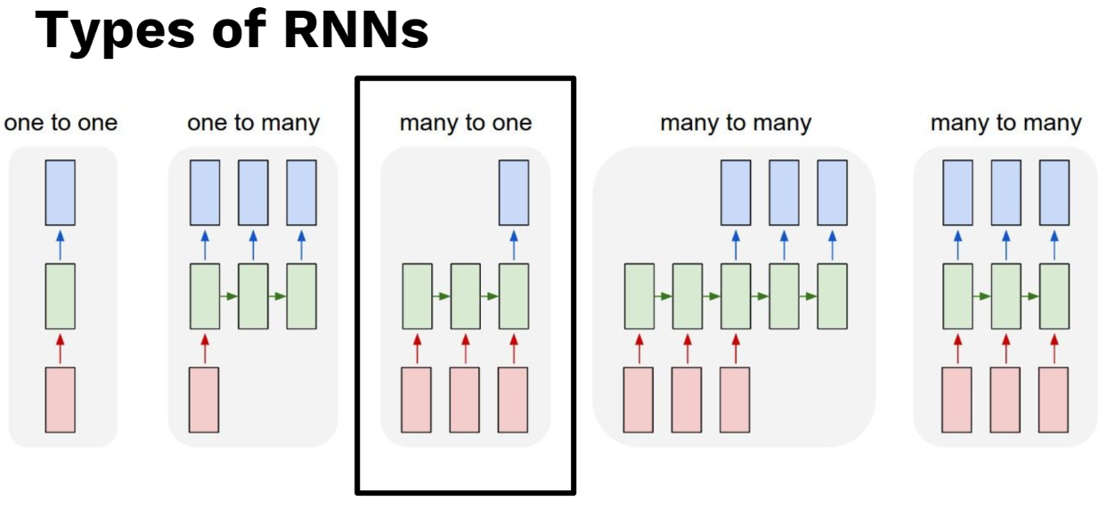

Slide 20
Do it yourself
Using Tensorflow API with Keras

Slide 21
Convolutional Neural Networks
An advantage of convolutional neural networks is that they are more parallelizable than RNNs
CNN takes a fixed size inputs and generates fixed-size outputs.
CNN is a type of feed-forward artificial neural network - are variations of multilayer perceptrons which are designed to use minimal amounts of preprocessing.
A CNN is basically a neural-based approach which represents a feature function that is applied to constituting words or n-grams to extract higher-level features. The resulting abstract features have been effectively used for sentiment analysis, machine translation, and question answering, among other tasks.
CNNs are ideal for computer vision. It has been adapted to NLP.

Slide 22
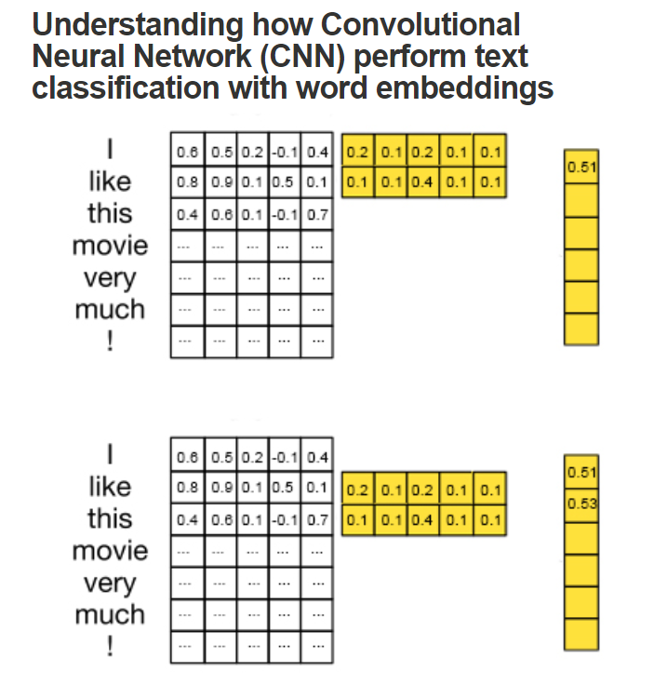
CNNs
(0.6 x 0.2 + 0.5 x 0.1 + … + 0.1 x 0.1 = 0.51)
(0.8 x 0.2 + 0.9 x 0.1 + … + 0.7 x 0.1 = 0.53)
Source: http://www.joshuakim.io/category/nlp/
Notes:
The workings of the CNN on word embeddings by focusing on the dimensionality of matrices in each intermediate step.
A CNN is basically a neural-based approach which represents a feature function that is applied to constituting words or n-grams to extract higher-level features. The resulting abstract features have been effectively used for sentiment analysis, machine translation, and question answering, among other tasks.

Slide 23
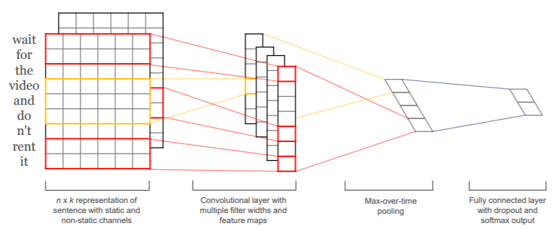
CNN Architecture for Text
Source: https://www.aclweb.org/anthology/D14-1181.pdf
Notes:
There is Max Pooling function. Reduce the amount of data, and reduce the dimension of the input size. Softmax, when you have multiple outputs, convert your output layers into a probability distribution.

Slide 24
Do it yourself

Slide 25
Pretrained language models
Enables learning models with significantly less data.
Additional benefit: Language models only require unlabelled data.
Enables application to low-resource languages where labelled data is scarce.
Notes:
A lot of the focus recently has been on these large unsupervised pretrained language models

Slide 26
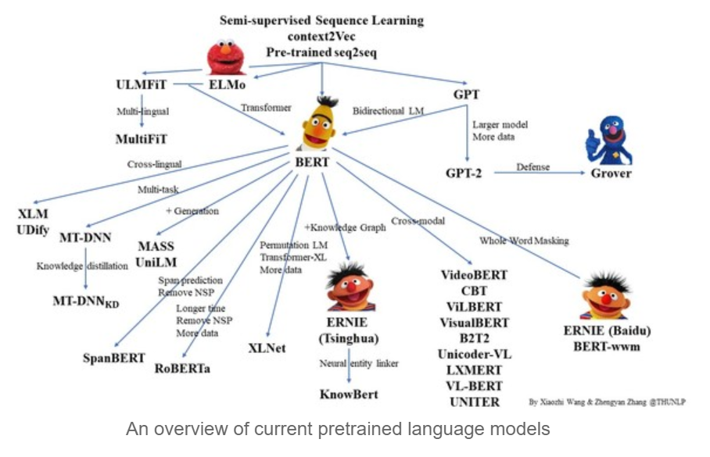
Image credit: https://github.com/thunlp/PLMpapers
Notes:
Pre-trained Language Model (PLM) is a very popular topic in NLP. The above shows their relationship with a diagram.

Slide 27
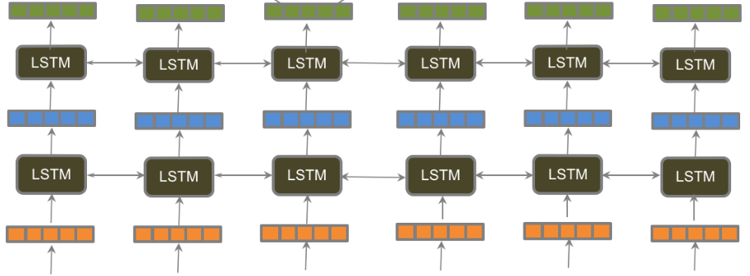
From Word Embeddings to Pretrained Language Models
?
?
?
?
He
went
to
prison
cell
with
his
cell
phone
Notes:
When using word2vec or GloVe, these two “cell” will have the same vectors although there meaning are completely different. While ELMo or BERT can generate different word embeddings for these two “cell”.

Slide 28
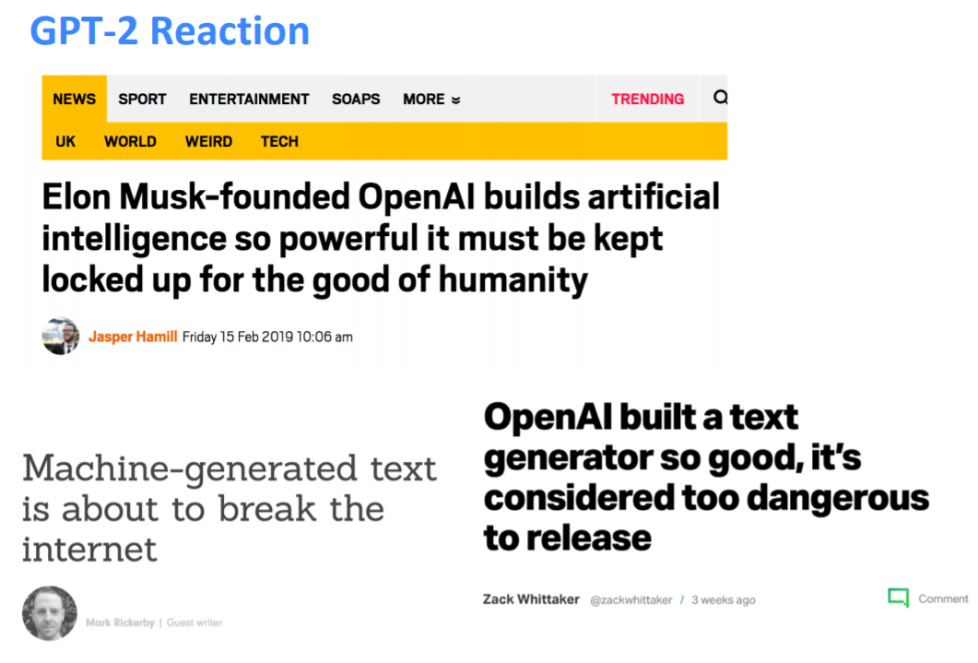
Notes:
You might have heard of GPT-2 reaction,

Slide 29
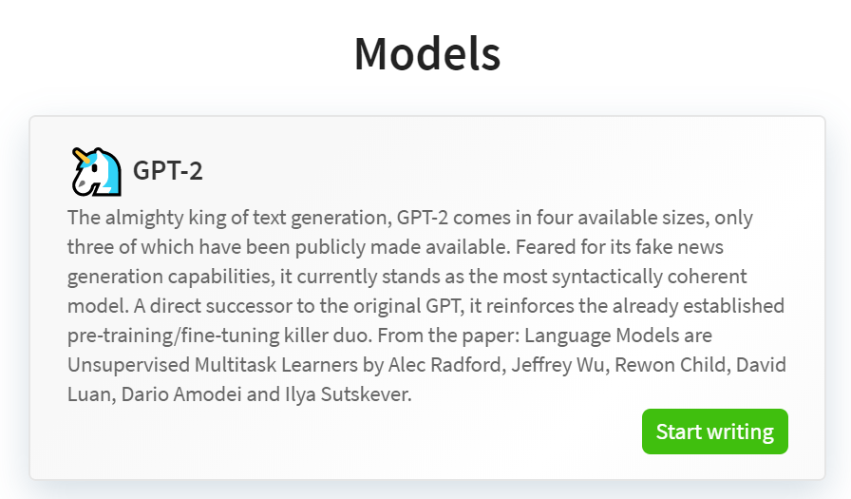
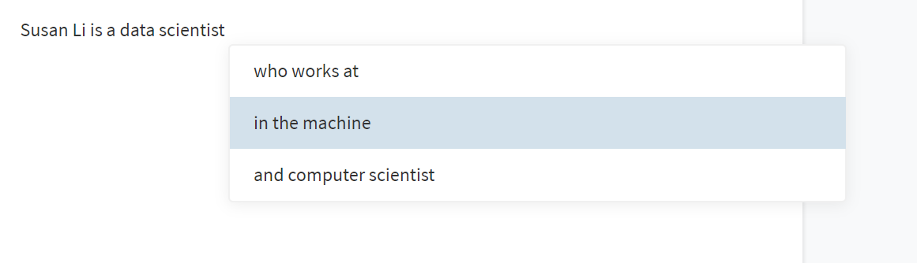
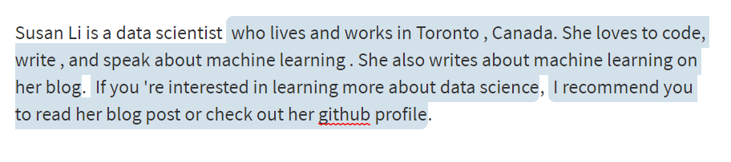
Language Modeling
This demo uses the public OpenAI
GPT-2 language model to generate sentences

Slide 30

NLP production
NLP research

Slide 31


Slide 32
Resources to learn
http://ruder.io/ Sebastian Ruder’s blog.
https://thegradient.pub/ founded in 2017 by a group of students and researchers at the Stanford Artificial Intelligence Laboratory (SAIL).
https://github.com/thunlp/PLMpapers Link to all the papers and repos on Pre-trained Language Model.
https://github.com/keon/awesome-nlp A curated list of resources dedicated to NLP.
https://arxiv.org/pdf/1301.3781.pdf Mikolov et al. 2013
https://papers.nips.cc/paper/5021-distributed-representations-of-words-and-phrases-and-their-compositionality.pdf - Mikolov et al. 2013
http://cs231n.github.io/convolutional-networks/#overview

